Slide 1
TERMS AND CONDITIONS
These PowerPoint slides are a tool for lecturers, and as such:
YOU MAY add content to the slides, delete content from the slides, print out the slides, and save the slides onto your computer or server.
YOU MAY NOT resell, reproduce or redistribute the content in any form whatsoever, without prior written permission from the copyright holder.
© Troupant Publishers (Pty) Ltd, 2016
Selected images used under licence from Shutterstock.com

Slide 2
Engineering Systems
NQF Level 2

Slide 3
Electronic systems
Module 2

Slide 4
Electronic systems and their components
Unit 2.1

Slide 5
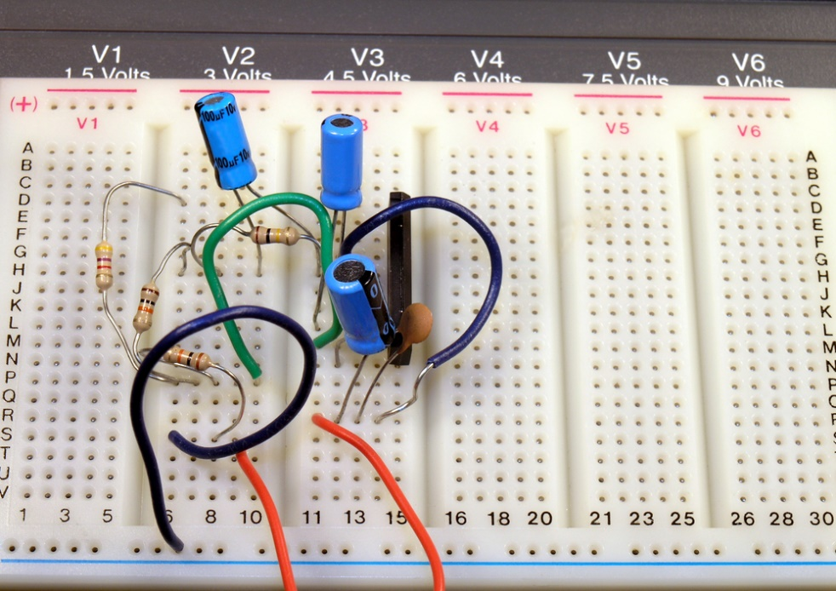
Electronic systems
Figure 2.1 An electronic circuit
diagram with some electronic
components
Figure 2.2 Experimenting with an electronic circuit using a breadboard

Slide 6
Resistors
A resistor is a two-terminal component that resists or opposes an electric current flow by developing a voltage drop across its terminals.
Used in most electronic circuits to control current.

Slide 7
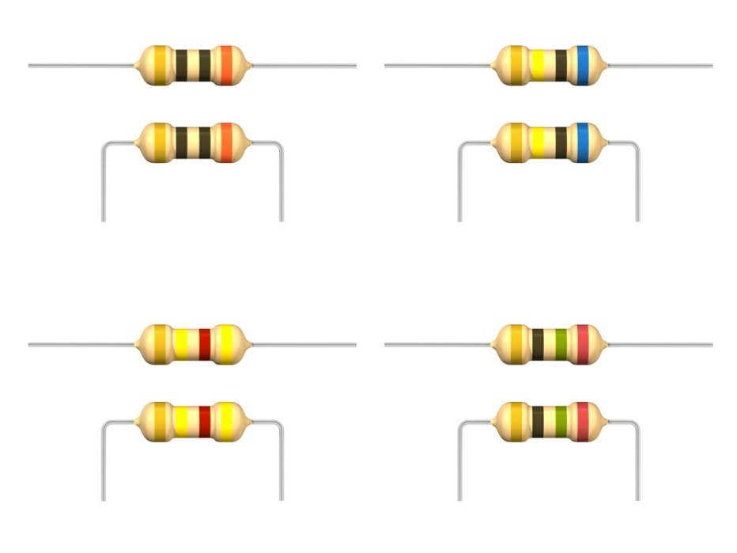
Resistors
Figure 2.3 Some resistors
Figure 2.4 The circuit
symbol of a resistor

Slide 8
Main types of resistors
Table 2.1 The main types of resistors
Type of resistor | Maximum value
Carbon composition | 20 MΩ
Carbon film | 10 MΩ
Metal oxide | 100 MΩ
Wire-wound | 270 MΩ

Slide 9
Identifying resistors using colour codes
Table 2.2 Resistor colours and their values
First three bands – resistance value: First band – first digit. Second band – second digit. Third band – multiplier (the number of zeros following the second digit).
Colour | Digit
Black | 0
Brown | 1
Red | 2
Orange | 3

Slide 10
Identifying resistors using colour codes
Table 2.2 Resistor colours and their values (continued)
Colour | Digit
Yellow | 4
Green | 5
Blue | 6
Violet | 7
Grey | 8
White | 9

Slide 11
Identifying resistors using colour codes
Table 2.2 Resistor colours and their values (continued)
Fourth band – tolerance
Colour | Tolerance
Gold | ±5%
Silver | ±10%
No band (i.e. no colour) | ±20%

Slide 12
How to use the colour code
Figure 2.5 A resistor colour code

Slide 13
Potentiometers or variable resistors
A potentiometer is a resistor you can adjust by turning a knob or spindle.
Also called a variable resistor or rheostat.
Typically used to control the volume of a radio.

Slide 14
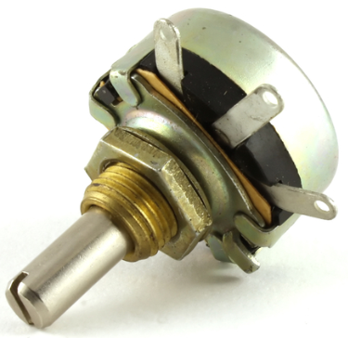
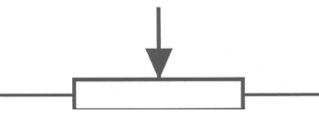
Potentiometers or variable resistors
A potentiometer
Figure 2.6 A potentiometer
Figure 2.7 Circuit symbol for a
potentiometer

Slide 15
Light-dependent resistors (LDRs)
A LDR is a special type of resistor whose resistance decreases the more light shines on it.
Also called a photoresistor.

Slide 16
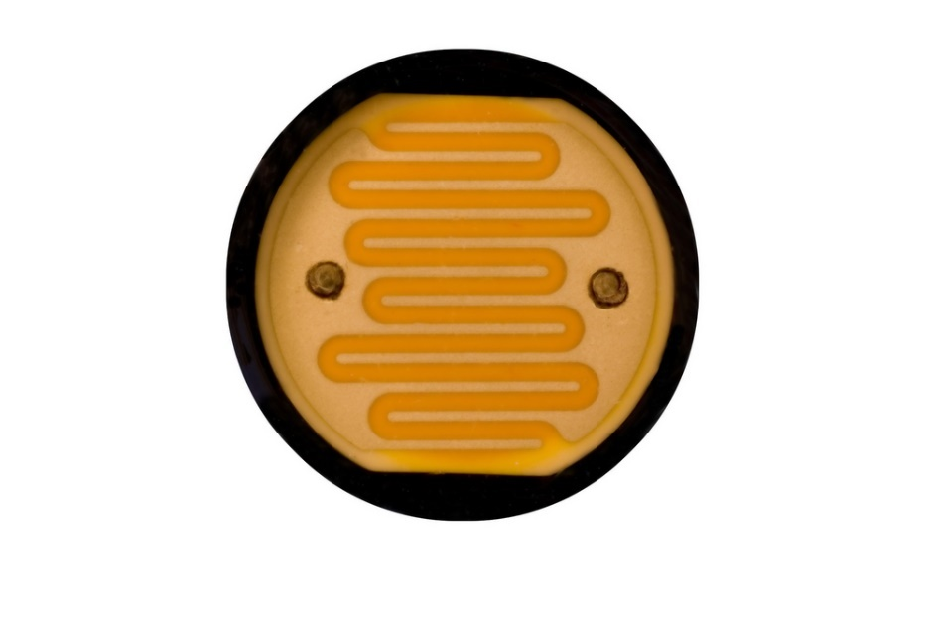
Light-dependent resistors (LDRs)
Figure 2.8 A light-dependent resistor (LDR)
Figure 2.9 Circuit symbol for a
light-dependent resistor

Slide 17
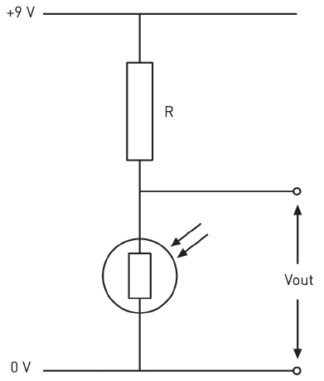
Light-dependent resistor circuits
Figure 2.10 Where output voltage increases in darkness

Slide 18
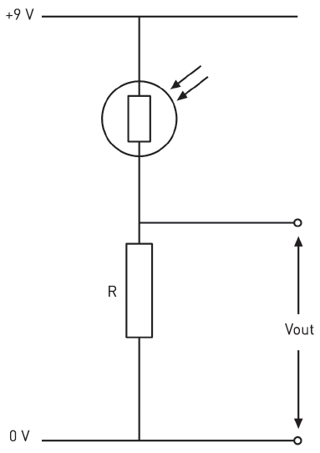
Light-dependent resistor circuits
Figure 2.11 Where output voltage increases when subject to a bright light

Slide 19
Thermistors
A thermistor is another special type of resistor that changes its value when there is a change in temperature.
When used in circuit it can convert a change in resistance to a change in voltage.
Can be used to control electric circuits.

Slide 20
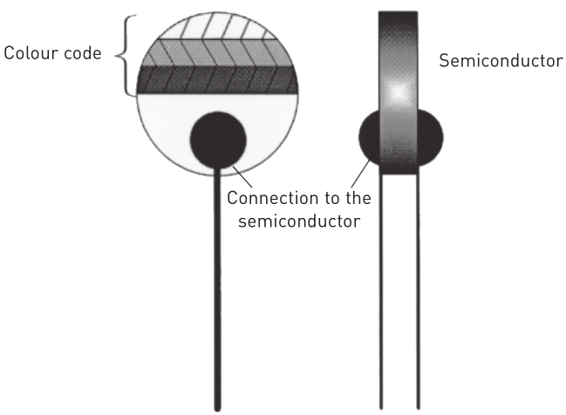
Thermistors
Figure 2.12 A thermistor
Figure 2.13 Circuit symbol for a thermistor

Slide 21
Thermistor circuit
Figure 2.14 Output voltage
increases as temperature increases
Figure 2.15 Output voltage
decreases as temperature increases

Slide 22
Capacitors
A capacitor is an electronic component that is used to store an electrical charge.
Its ability to store a charge is measured by its capacitance (C) in units of farad (F).
A capacitor consists of one or more pairs of conductors separated by a dielectric (insulator).

Slide 23
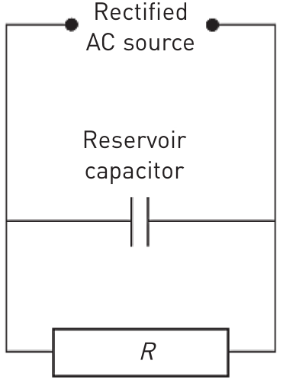
Capacitors
Types of capacitors:
Fixed-value capacitors.
Variable capacitors.
Figure 2.16 An electrolytic capacitor connected in
parallel to the load (fixed-value capacitor)

Slide 24
Comparing types of capacitors
Fixed-value capacitors
Circuit symbols:
Figure 2.17 Circuit symbols for fixed-value capacitors

Slide 25
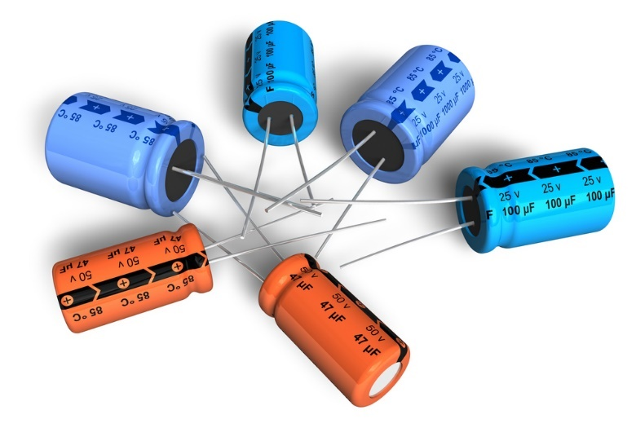
Comparing types of capacitors
Fixed-value capacitors (continued)
Polarised capacitors
Figure 2.19 Polarised electrolytic capacitors

Slide 26
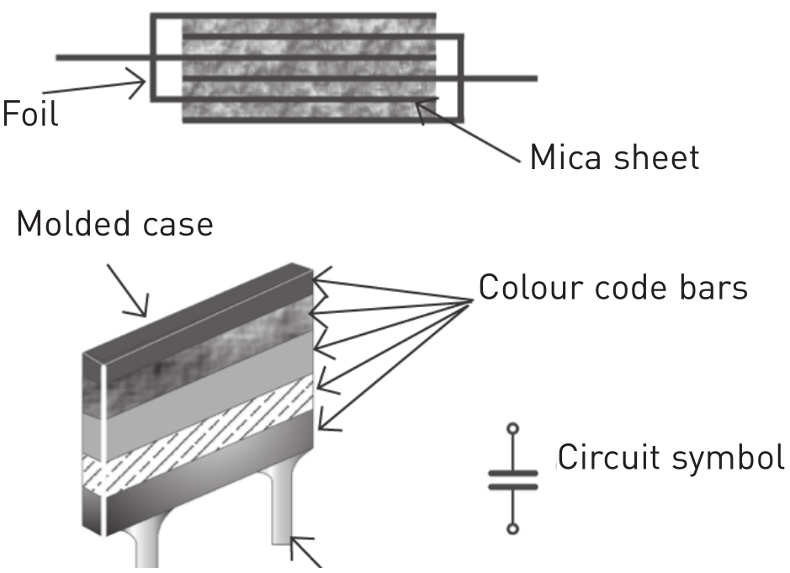
Comparing types of capacitors
Fixed-value capacitors (continued)
Non-polarised capacitors
Figure 2.20 A mica capacitor

Slide 27
Comparing types of capacitors
Variable capacitors
Figure 2.18 Circuit symbol for variable capacitor

Slide 28
VIDEO: Mabena studying

Slide 29
Inductors
An inductor is an electronic component that can store energy in a magnetic field created by the electrical current passing through it.
An inductor’s ability to store a charge is measured by inductance (L) in units of henries (H).
Also called a coil because it’s made up of conducting wire shaped as a coil.

Slide 30
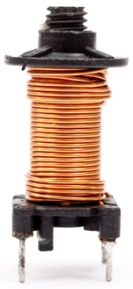
Inductors
Figure 2.21 An inductor

Slide 31
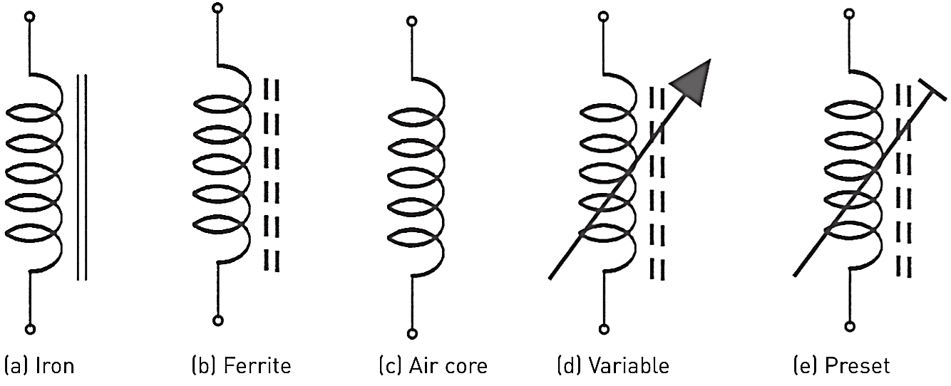
Inductors
Circuit symbols
Figure 2.22 Symbols for different types of inductors

Slide 32
Transformers
A transformer is a device that transfers electrical energy from one circuit to another by electromagnetic induction.
Electrical energy is always transferred without a change in the frequency.
It must be used with an input source voltage that varies in amplitude.

Slide 33
Transformers
Transformers consist of:
A primary coil or winding connected to the supply.
A secondary coil or winding connected to the load.
A core of soft ferromagnetic material that supports the coil or winding.

Slide 34
Transformers
Figure 2.23 A transformer

Slide 35
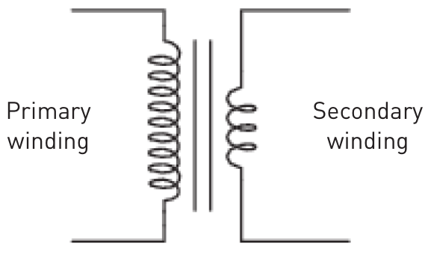
Transformers
Figure 2.24 The circuit symbol for a transformer

Slide 36
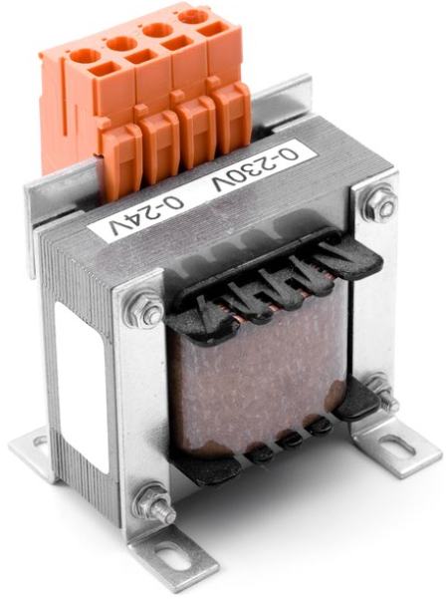
Transformers
Figure 2.25 A step-down transformer

Slide 37
Diodes
A diode is a semiconductor device that allows electric current to flow in only one direction.
Diodes have forward bias and reverse bias.
Used to regulate voltage, to protect circuits from high-voltage surges, to tune radio and TV receivers, to generate radio frequency oscillations and to produce light.

Slide 38
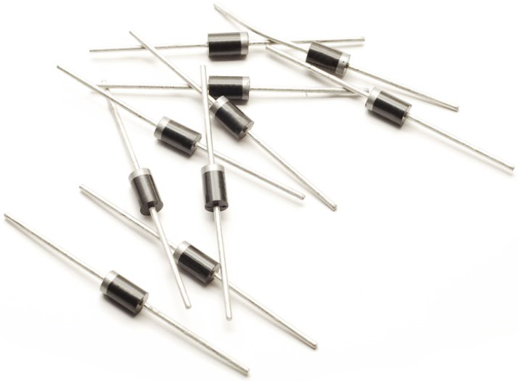
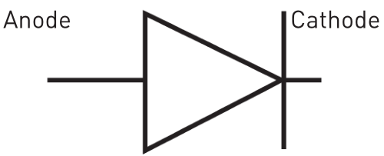
Diodes
Figure 2.26 Diodes
Figure 2.27 The circuit symbol for a diode

Slide 39
Diodes
Diode in forward bias | Diode in reverse bias
Figure 2.28 Diode in forward bias
Figure 2.29 Diode in reverse bias

Slide 40
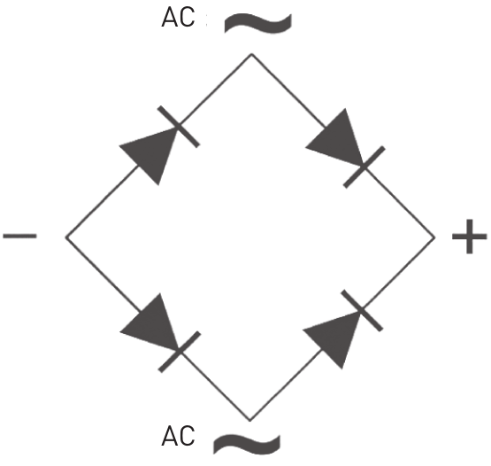
Some special types of diodes
Rectifiers
Figure 2.30 A typical bridge rectifier

Slide 41
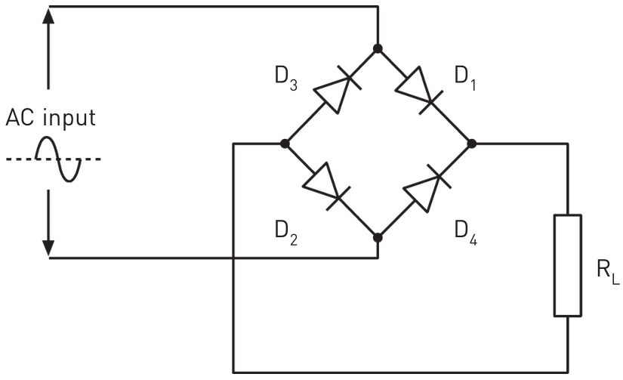
Some special types of diodes
Rectifiers
Figure 2.31 A bridge rectifier in a circuit

Slide 42
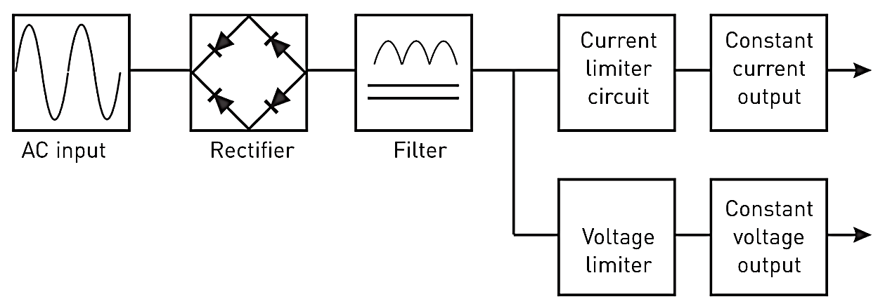
Rectifiers
Some special types of diodes
Figure 2.32 Block diagram of a DC power supply

Slide 43
Light-emitting diodes (LEDs)
A LED is a semiconductor device that emits light.
Used as indicator lamps in many devices, e.g. traffic signals, vehicle lights and aviation lighting.
Also used in domestic appliances and remote controls.

Slide 44
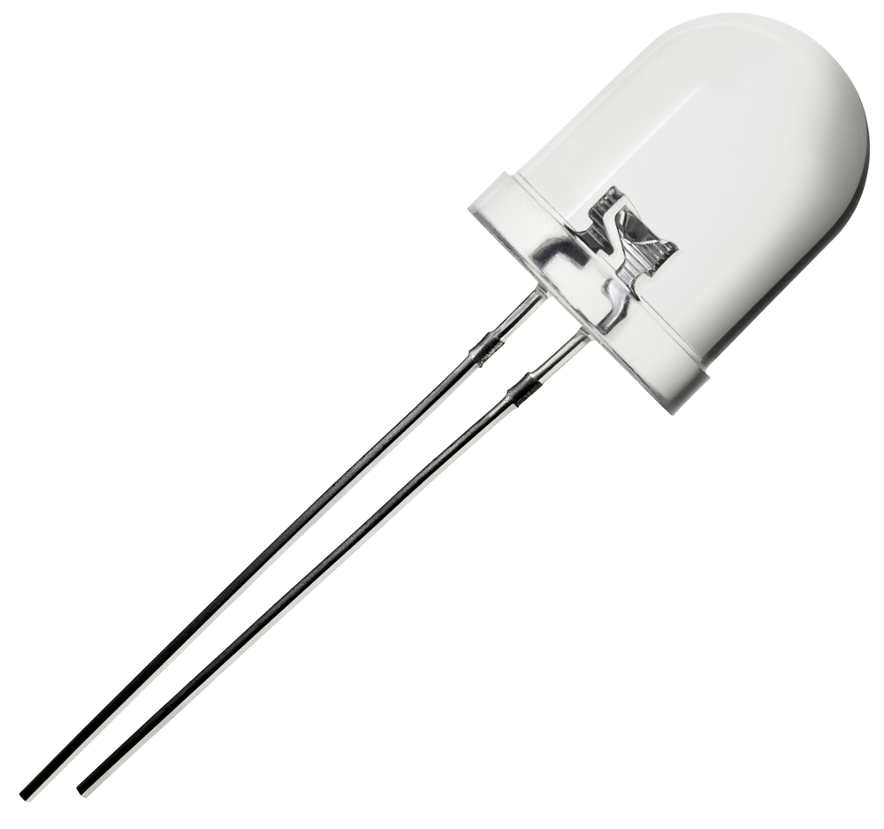
Light-emitting diodes (LEDs)
Figure 2.33 An LED

Slide 45
Light-emitting diodes
Figure 2.34 The symbol for an LED
Figure 2.35 Series resistor connected to LED

Slide 46
Zener diodes
Zener diodes are used to regulate voltage.
When the voltage across the diode reaches the value of the Zener voltage, the diode starts to conduct. When it conducts the voltage remains constant at the rated value.

Slide 47
Zener diodes
Figure 2.36 Zener diodes

Slide 48
Zener diodes
Figure 2.37 The circuit symbol
for a zener diode
Figure 2.38 A zener diode used in regulator circuit

Slide 49
Transistors
A transistor is a solid-state electronic device used for switching and amplification of electronic signals.
It is made of semiconductor materials with three terminals for connection to an external circuit.

Slide 50
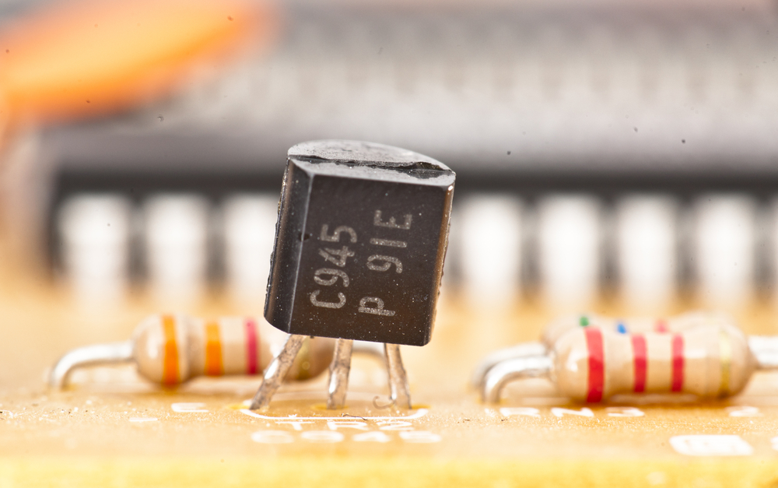
Transistors
Figure 2.39 A transistor in a circuit

Slide 51
Transistors
Figure 2.40 Diode configuration for an N-P-N transistor

Slide 52
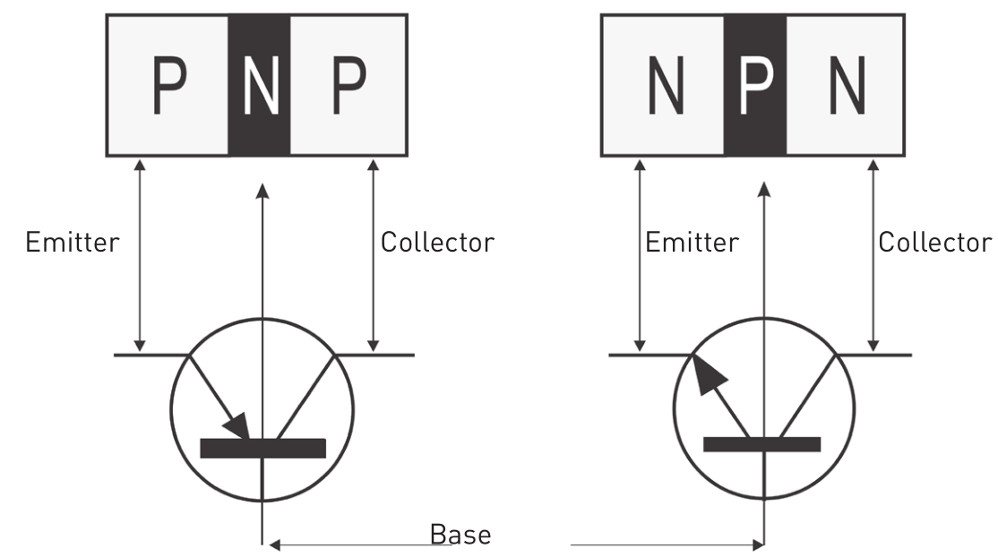
Transistors
Figure 2.41 P-N-P and N-P-N transistors

Slide 53
Using a transistor as a switch
Figure 2.42 Using a transistor as a switch

Slide 54
Using diodes to protect transistors
Figure 2.43 Using a diode to
protect a transistor

Slide 55
Common ISO electronic symbols
Table 2.4 The most common ISO electronic symbols

Slide 56
Common ISO electronic symbols
Table 2.4 The most common ISO electronic symbols (continued)

Slide 57
Common ISO electronic symbols
Table 2.4 The most common ISO electronic symbols (continued)

Slide 58
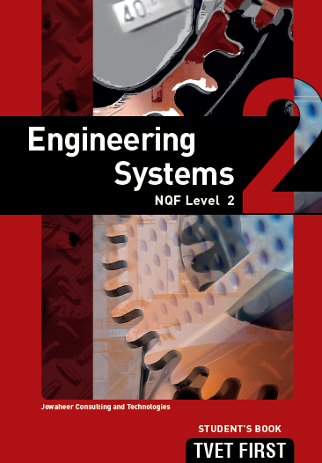
Summative assessment
Test your knowledge of this section by completing the Summative assessment (page 40 of your Student’s Book)

